Slide 1

TEN YEARS OF NETWORK AUTOMATION AT LINX
Riccardo Verzeni
Director of Software Engineering

Slide 2
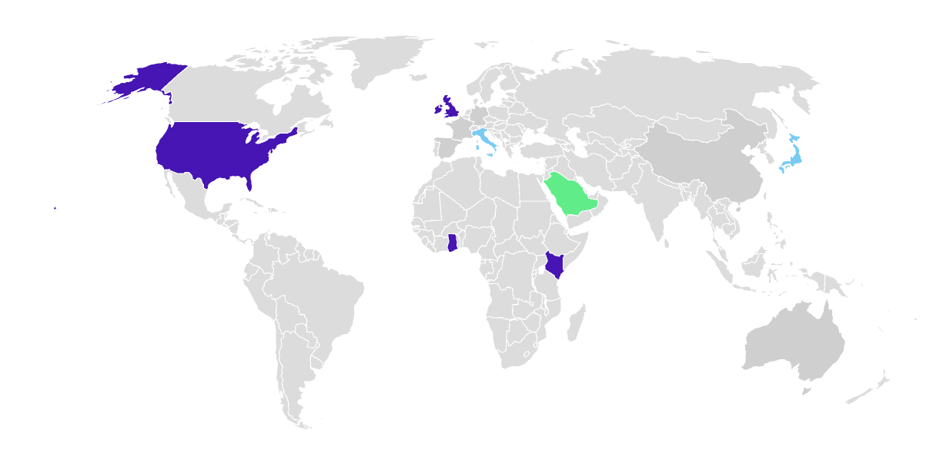
LINX Network Environment
LINX IXPs​
LINX IXP Partners​
IXPs Powered by LINX​
Large Internet Exchange Point infrastructure
Multiple switching fabrics and vendors
Thousands of BGP sessions and member connections
Continuous operational changes and service provisioning
Automation required to scale operations safely

Slide 3
What does an IXP actually configure?
Customer Edge Interfaces
Customer port provisioning
MAC ACLs for port security
Rate limiting and traffic controls
Quarantine / validation testing before activation
Peering Infrastructure
Thousands of BGP sessions on route servers
Per-member routing policies
Core Fabric
Inter-switch links (ISLs) provisioning
VLAN and fabric configuration
Network state consistency across multiple switches

Slide 4
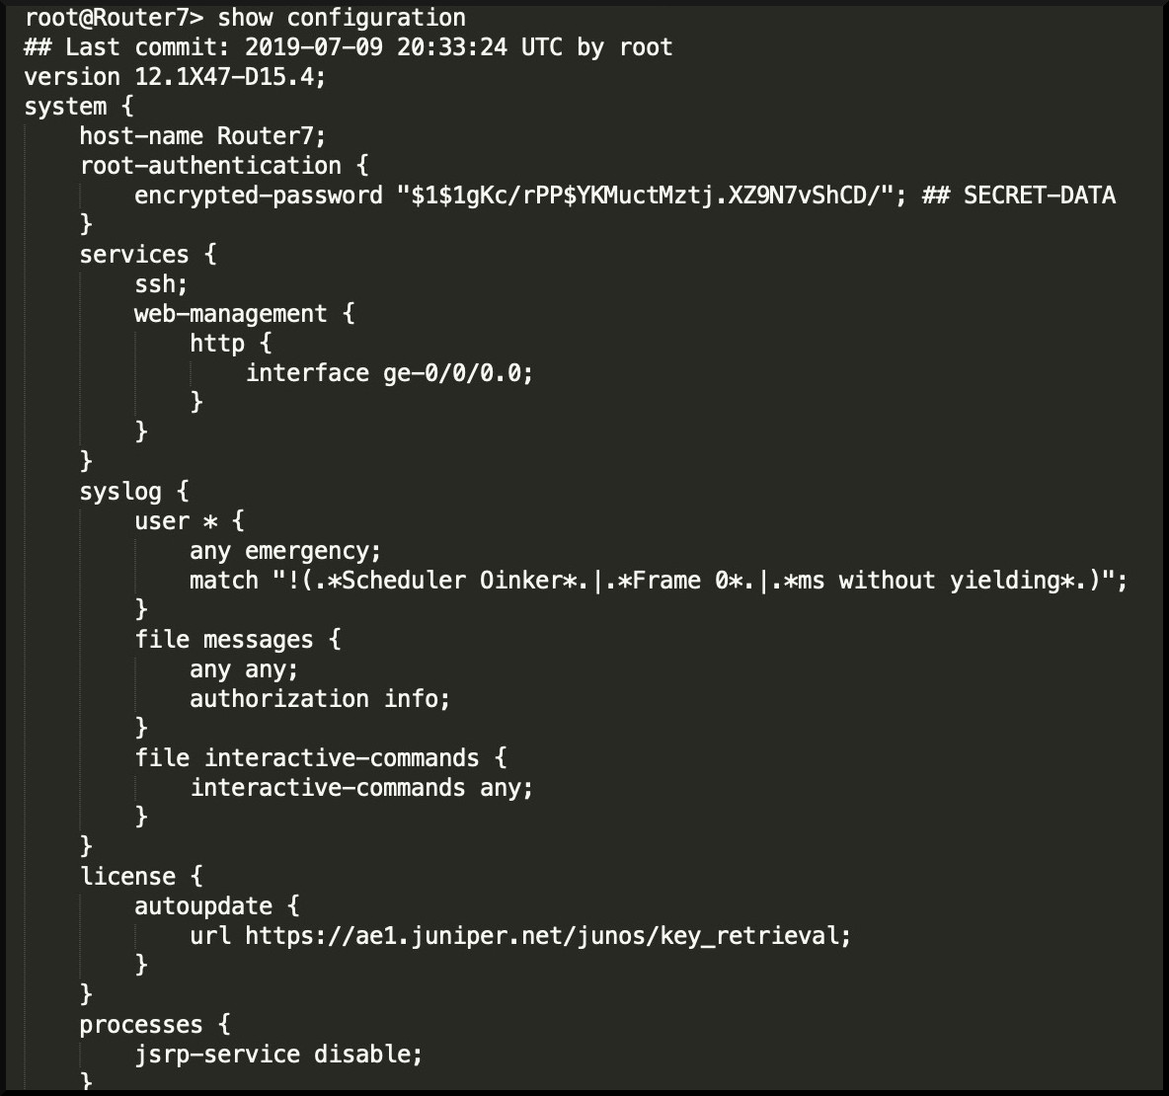
The Starting Point
Network configuration changes performed manually
CLI driven operational workflows
High operational overhead
Difficult to audit and review changes
Scaling network growth required automation

Slide 5
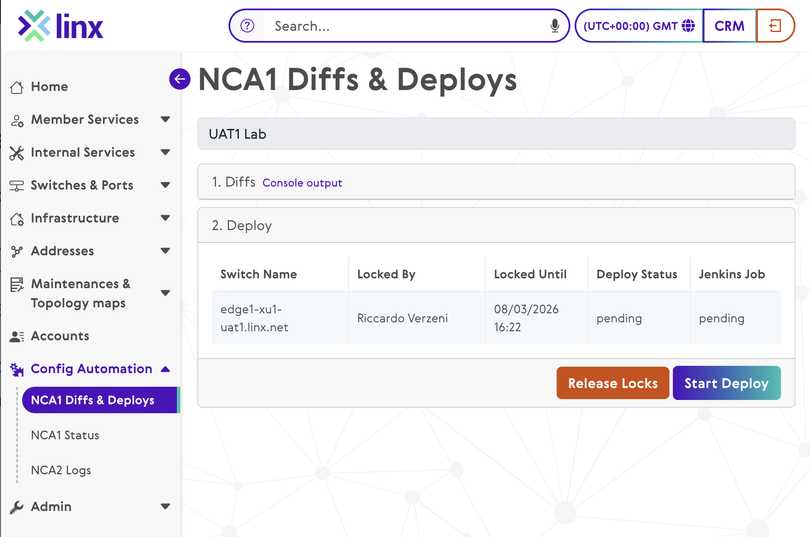
Phase 1 – Network Configuration Automation (NCA)
First generation automation platform
Generate configuration from structured data
Templates used to build device configuration
Diff generated before deployment
Controlled and safe deployment pipeline

Slide 6
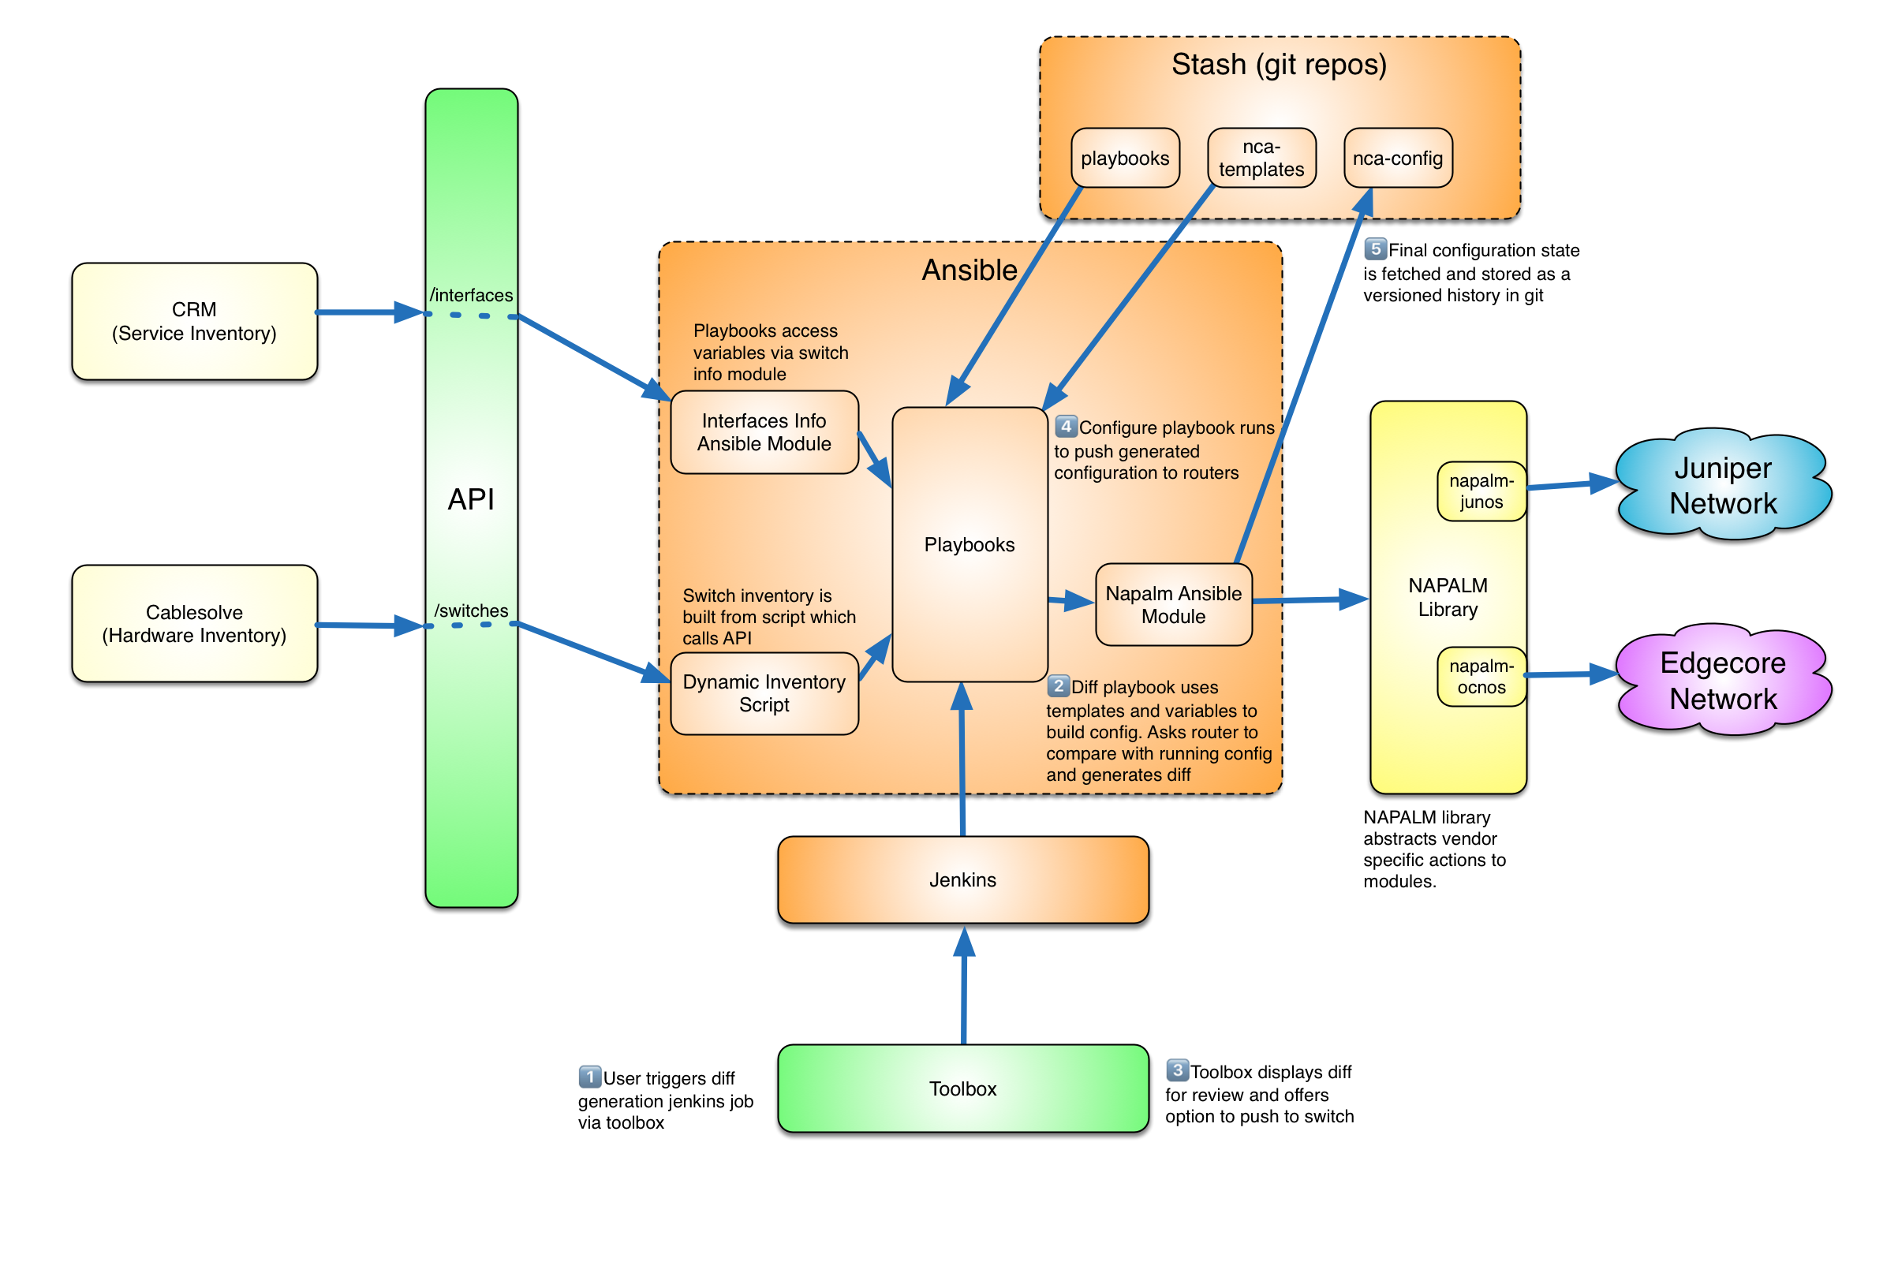
NCA Architecture
Inventory and data APIs as source of truth
Templates generated with Jinja2
Automation executed via Ansible and NAPALM
Deployment pipeline orchestrated through CI tooling: Jenkins
Full logging and configuration history in git

Slide 7
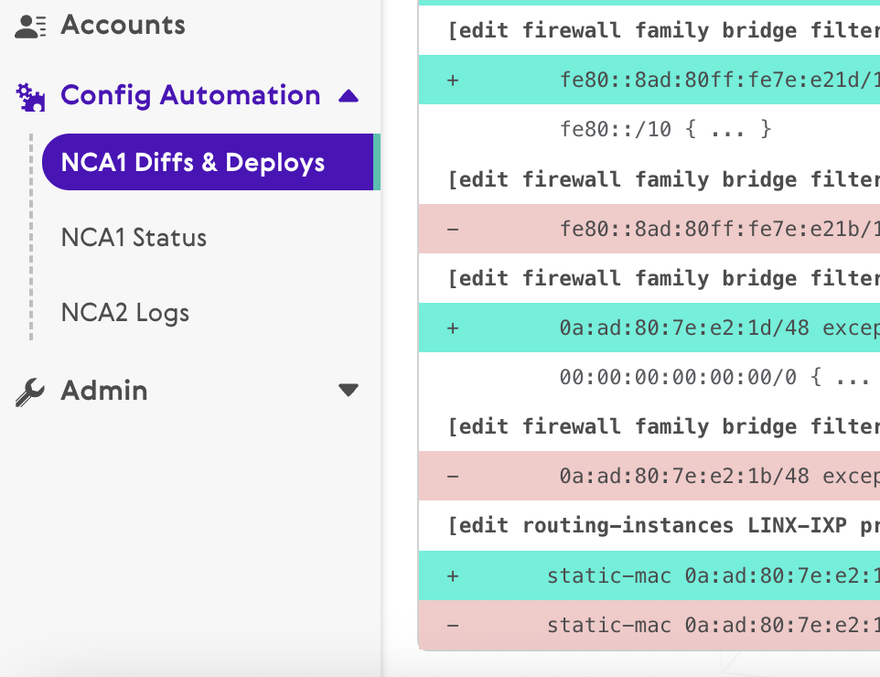
Why NCA Was Important
Configuration as Code
Deterministic configuration generation from structured data
Standardised configuration templates for all customer interfaces
Safe Change Management
Reviewable diffs generated before deployment
Automated validation and safeguards in the deployment pipeline

Slide 8
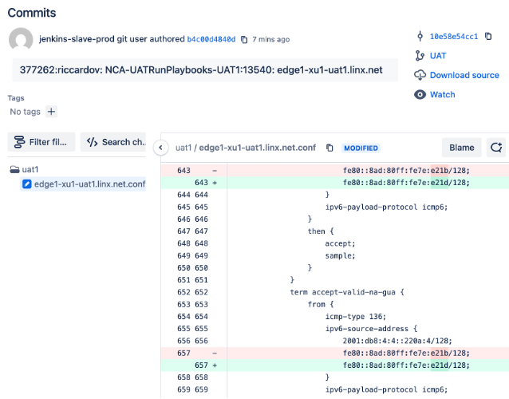
Why NCA Was Important
Operational Visibility
Full configuration history and auditability via Git
Traceable change history across the network
Operational Impact
Significant reduction in manual CLI changes
Safer, repeatable network operations

Slide 9
Lessons from Phase 1
Automation requires reliable data models
We later created bespoke SoT (TSI) because at the time no suitable solution was found available on the market
Cross-team collaboration between network and software
Testing environments are critical
Split between DEV/UAT/PROD environment

Slide 10
Lessons from Phase 1
Safety mechanisms are essential:
locking mechanisms
serialized deploys
validation checks
logs and audit trails
Automation must integrate with operational processes (E.g: Network maintenances)

Slide 11
Our Source of Truth: TSI & ENG-UI
TSI — our bespoke Source of Truth, holding inventory and service data; It represents the desired state of the network.
ENG-UI — the engineering UI on top of TSI, used by NOC and engineers to perform network-state changes before applying them and to provision services manually
Why bespoke — we had a telco's data and technical workflows but not its scale, and nothing on the market fit at the time (today we’d probably use NetBox or similar)

Slide 12
Phase 2 – Next Challenge: Member Driven Automation
Limitations of the first generation (NCA)
Reliable and safe, but optimised for bulk operational changes
Execution model too slow for real-time member requests
Required operator supervision
New operational requirement
Member self-service through the portal
Faster provisioning workflows
Unsupervised automation for low-risk changes
Notes:
Resulted into NCA 2.0
Asynchronous automation designed for member-driven operations

Slide 13
NCA 2.0
NCA | NCA 2.0
supervised | unsupervised
synchronous | asynchronous
internal ops | member facing
NCA 2.0 was designed specifically for low-risk automated configuration merges triggered by customer portal.

Slide 14
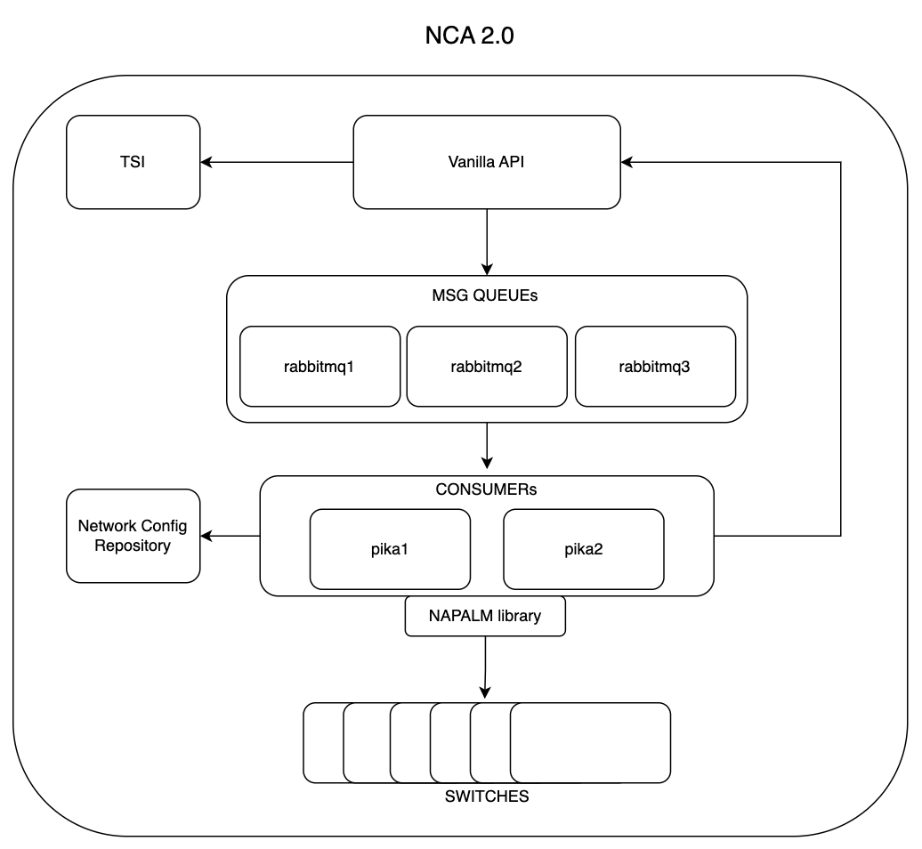
NCA 2.0 Architecture
4.b
4.a
1. API Action
↓
2. Message Queue
↓
3. Worker deploys change
↓
4. Inventory updated
1
1
4.b
2
3
Notes:
1. Action-driven automation
• Service actions are triggered via the NCA Actions API
• The API request represents the desired change
2. Event-driven execution
• Actions are pushed to message queues
• Asynchronous workers process deployment tasks
3. Stateless automation workers
• Consumers deploy changes using the NAPALM library
• changes are applied as a config merge
4. Post-deployment state update
• On successful deployment, the configuration repository is updated
• The inventory system (TSI) is updated via API
Full auditability:
• Configuration history stored in Git
• Automation actions and logs exposed via API
Key idea: the API action represents intent; the inventory is updated only after a successful deployment.

Slide 15
Phase 3 – Service Automation
Configuration automation alone was not sufficient
Service provisioning required coordination across multiple systems
Systems involved:
Member portal (and IX-API)
BSS inventory (CRM)
OSS inventory (SoT) (TSI / Cablesolve)
Ticketing systems
Notes:
This led to the development of the Order Management System (OMS).

Slide 16
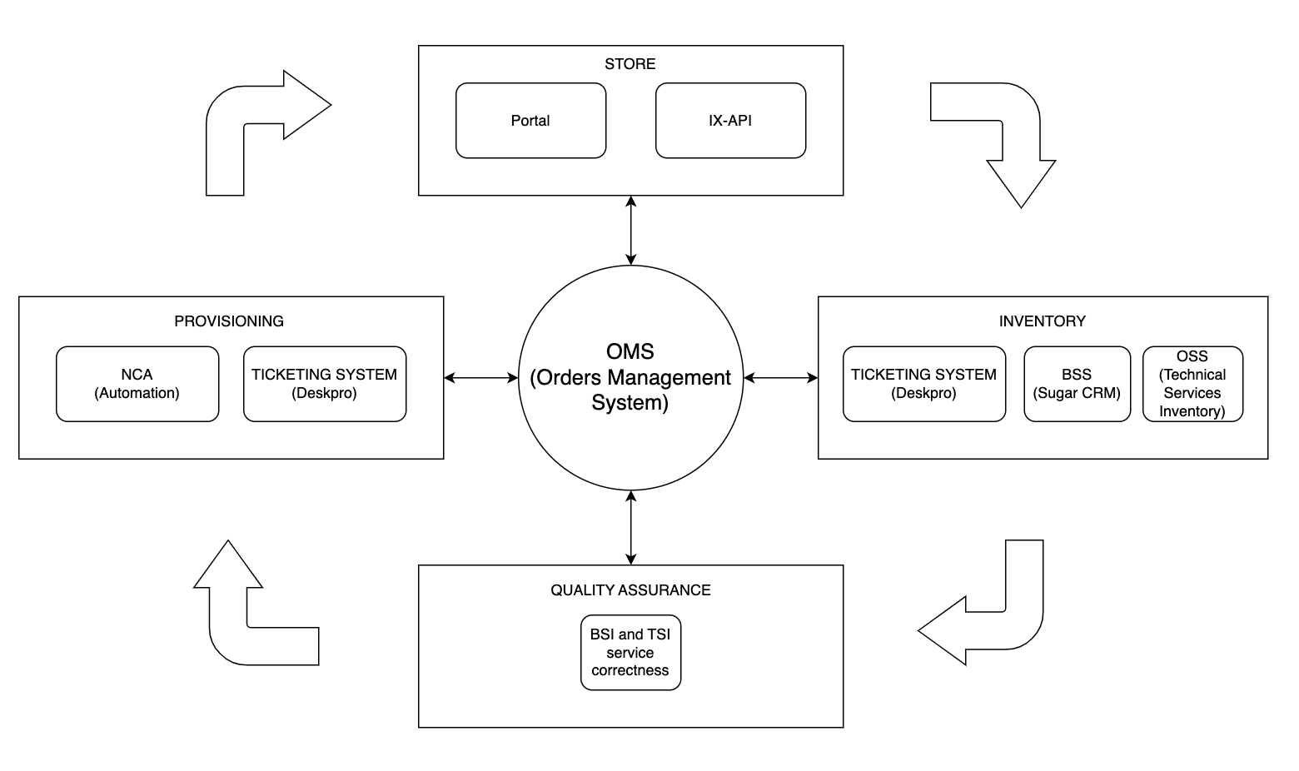
Order Management System (OMS)
1
1. Store
↓
2. Inventory
↓
3. Quality Assurance
↓
4. Provisioning
4
2
3
Notes:
OMS orchestrates service-provisioning workflows.
Integrates multiple systems:
• Portal / IX-API
• BSS inventory (CRM)
• OSS inventory (SoT)
• Ticketing system
• Network automation (NCA 2.0)
Uses messaging queues for asynchronous processing.
Manages the service lifecycle:
• Inventory update
• Quality assurance
• Provisioning
Exposes order status to members and operations.

Slide 17
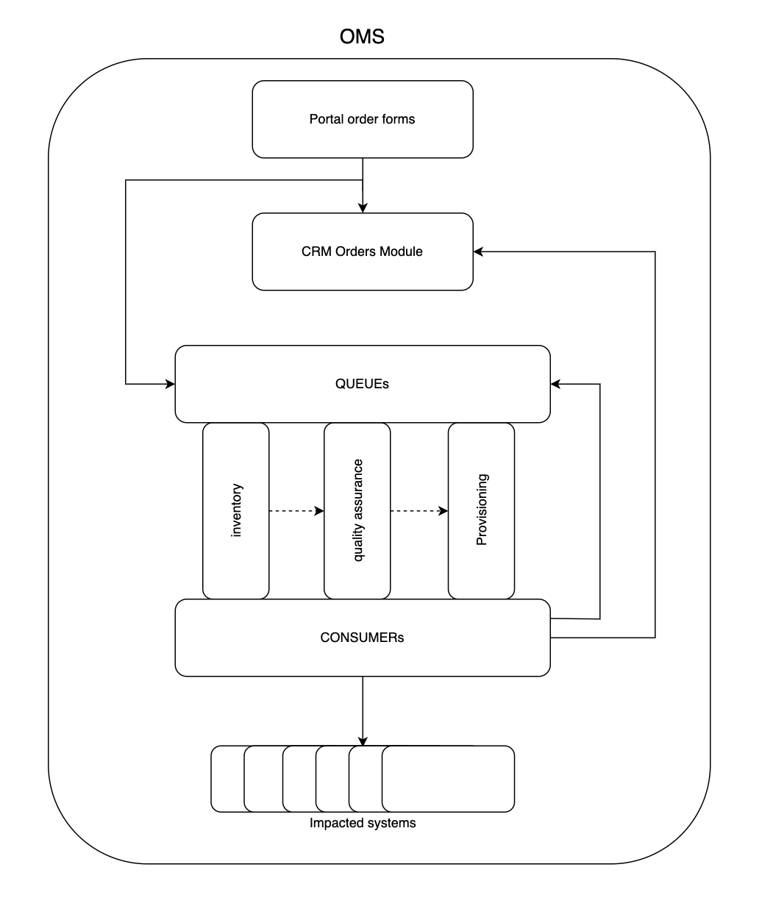
OMS Architecture
1
1. Order submission
↓
2. OMS processes order through lifecycle queues
↓
3. Execution on impacted systems
↓
4. Status updates
4
2
3
Notes:
Service-driven automation:
• Orders originate from member portal workflows
• Order state stored in the CRM Orders module
Event-driven orchestration:
• Orders pushed to messaging queues
• Order items processed asynchronously through multiple stages
Pipeline-based processing — queues represent service-lifecycle stages:
• Inventory validation
• Quality assurance
• Provisioning
Integration with operational systems — consumers interact with:
• BSS inventory (CRM)
• OSS inventory
• Ticketing system
• Network automation (NCA 2.0)
Full lifecycle visibility:
• Order status and logs updated throughout the workflow
• Progress exposed to both the member portal and internal operations

Slide 18
From OMS to Self-Service
With OMS in place, we could finally open provisioning up to members
In practice, provisioning ran through ENG-UI — NOC carried out the provisioning workflows by hand and deployed the changes via NCA
With OMS we started cannibalising the manual steps — automating them away one by one, moving NOC from doing the work to handling exceptions
Then we moved to the harder cases — some workflows can't be fully automated — which is where hybrid automation comes in

Slide 19
Hybrid Automation: The Pause–Resume Model
Some service workflows require external actions before automation can proceed.
Pause–Resume automation model
OMS pauses the workflow when external action is required
Automation resumes automatically once the condition is satisfied
Actors involved
Members via Portal
Operations via ENG-UI — the engineering UI on top of TSI

Slide 20
Hybrid Automation: Use Cases
Quarantine testing
Members must verify configuration on their router before activation
Private VLAN provisioning
Automation pauses until the invited member accepts the connection
Physical port provisioning
NOC performs patching or ODF configuration before deployment

Slide 21
Example: Automated Quarantine Testing
Before activating a new peering service — or when modifying critical parameters (e.g. MAC address) — the port is placed in a quarantine VLAN.
Automated workflow
Port provisioned in quarantine mode
OMS pauses provisioning workflow
Member validates router configuration
Member resumes provisioning via Portal
Automation completes service activation
Notes:
Purpose:
Validate member router configuration
Ensure correct BGP behaviour
Prevent misconfigured routers affecting the fabric with prohibited traffic types
OMS is not just automation orchestration; it is also a coordination mechanism between systems, operators, and members.

Slide 22
Route Server Automation (RSA): Scope & Architecture
Automation beyond switching
Management of thousands of BGP sessions
Automated route server configuration
Shared automation architecture
Built on the same event-driven messaging system
Asynchronous execution model

Slide 23
Route Server Automation (RSA): Config Model & Impact
Different configuration model
Configuration compiled dynamically
Combines internal inventory with public routing datasets
Operational impact
Reduced manual management of BGP sessions
Consistent route server configuration across fabrics

Slide 24
LINX Network Automation Ecosystem
SERVICE INTERFACES
Member Portal · IX-API · ENG-UI
SUPPORTING
SYSTEMS
CRM / BSS
OSS inventory
Ticketing
ORCHESTRATION
OMS — service lifecycle management
AUTOMATION ENGINES
NCA · NCA 2.0 (switching) · RSA (route servers)
NETWORK INFRASTRUCTURE
Switching fabric · Route servers

Slide 25
Mapping Our Architecture to the NAF Reference Framework
NAF FRAMEWORK
LINX IMPLEMENTATION
User / Systems Interface
Portal · IX-API · ENG-UI
Automation Orchestration
OMS (Order Management System)
Automation Engines
NCA · NCA 2.0 · RSA
Network Infrastructure
Network Devices
Notes:
Key ideas: Modularity, Vendor-neutrality

Slide 26
Lessons from 10 Years of Automation
Data is the foundation — reliable inventory and service data are what everything else is built on
Automation evolves incrementally — capability compounds; start small and earn trust in each next phase
Think beyond the network — real service delivery needs orchestration across systems
Hybrid wins — manual and automated workflows coexisting is what builds resilience

Slide 27
DO
From principles to practice — how to put the lessons to work
Separate commercial & technical data / systems — but keep them loosely coupled so you can audit and reconcile across both
Automate with software best practices — version control, DEV/UAT/PROD, CI/CD, automated testing; no unmaintained scripts running on someone's laptop
Start from the most common use case — leave the rest manual, then expand progressively through trial and error
Match architecture to the operation — synchronous for sporadic ops, asynchronous (queues + consumers) for frequent, multi-user ones like self-service
Notes:
DO — talking points:
Separate commercial & technical data — keep them loosely coupled so you can audit and reconcile across the two without one schema dragging the other around. Different users with different workflows require different systems.
Automate with software best practices — version control, split DEV/UAT/PROD, CI/CD pipelines, automated testing where possible. The anti-pattern: no unmaintained "magical" scripts running off someone's laptop.
Start from the most common use case — leave everything else manual and expand progressively through trial and error.
Match architecture to operation — Synchronous = NCA: NOC operations, engineering maintenances, big scheduled network maintenances. Powered by task schedulers (Jenkins) + config management (Ansible). Asynchronous = NCA 2.0 and OMS: member self-service, frequent and multi-user. Powered by messaging queues + consumers.

Slide 28
DON'T
From principles to practice — what to avoid
Don't build bespoke by default — build only what you need; if an open-source tool fits or is built to extend, use it
Don't work in isolation — bring every stakeholder in from day one and keep regular show-and-tells as you build
Don't over-engineer error handling — defaulting to a human for the corner cases is usually the most cost-effective option
Don't underestimate guardrails — for catastrophic-risk actions, hash-verify pushed files and cut impact radius, or keep a human in the loop
Notes:
DON'T — talking points:
Don't build bespoke by default — we built TSI (and its UI, ENG-UI) because we had the same data and technical workflows as a telco but not the scale, and nothing on the market fit at the time. Today we'd probably use NetBox.
Don't work in isolation — bring all relevant stakeholders in from the start; keep doing regular show-and-tells as development progresses.
Don't over-engineer error handling — defaulting to a human for the corner cases is usually the most cost-effective solution.
Don't underestimate guardrails / human-in-the-loop — for catastrophic-risk actions: hash-verify the files being pushed; use NCA's pre-deploy diff and OMS's QA step as gates. We used "replace" config for human-supervised NCA, and "merge" config for the unsupervised NCA 2.0 and OMS. Reduce the tool's blast radius; where you can't, keep a human in the loop for confirmation.

Slide 29
Questions?

